Slide 1
Operating System
Lecture 22: Distributed Coordination
Manoj Kumar Jain
M.L. Sukhadia University Udaipur

Slide 2
Outline
Event Ordering
Mutual Exclusion
Atomicity
Concurrency Control
Manoj Kumar Jain Professor Computer Science MLSU Udaipur

Slide 3
Event Ordering
Happened-before relation (denoted by →).
  If A and B are events in the same process, and A was executed before B, then A → B.
  If A is the event of sending a message by one process and B is the event of receiving that message by another process, then A → B.
  If A → B and B → C then A → C.
Manoj Kumar Jain Professor Computer Science MLSU Udaipur

Slide 4
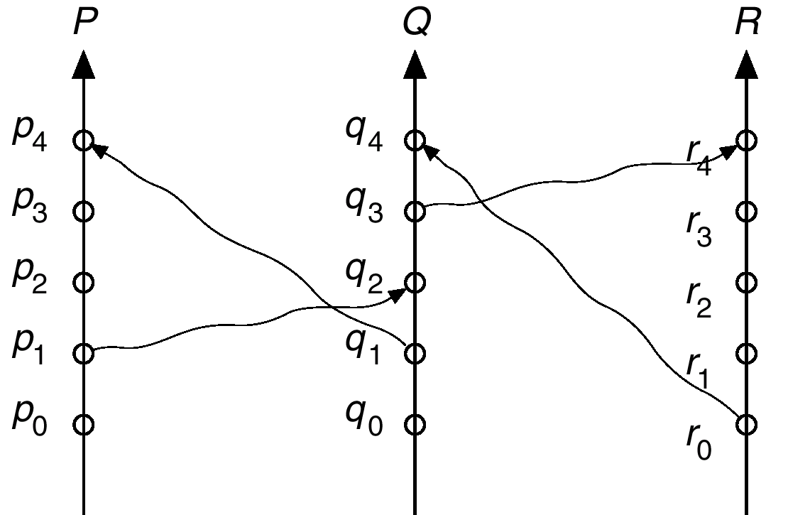
Relative Time for Three Concurrent Processes
Manoj Kumar Jain Professor Computer Science MLSU Udaipur

Slide 5
Implementation of →
Associate a timestamp with each system event. Require that for every pair of events A and B, if A → B, then the timestamp of A is less than the timestamp of B.
Within each process P_{i} a logical clock, LC_{i} is associated. The logical clock can be implemented as a simple counter that is incremented between any two successive events executed within a process.
A process advances its logical clock when it receives a message whose timestamp is greater than the current value of its logical clock.
If the timestamps of two events A and B are the same, then the events are concurrent. We may use the process identity numbers to break ties and to create a total ordering.
Manoj Kumar Jain Professor Computer Science MLSU Udaipur

Slide 6
Distributed Mutual Exclusion (DME)
Assumptions
  The system consists of n processes; each process P_{i} resides at a different processor.
  Each process has a critical section that requires mutual exclusion.
Requirement
  If P_{i} is executing in its critical section, then no other process P_{j} is executing in its critical section.
We present two algorithms to ensure the mutual exclusion execution of processes in their critical sections.
Manoj Kumar Jain Professor Computer Science MLSU Udaipur

Slide 7
DME: Centralized Approach
One of the processes in the system is chosen to coordinate the entry to the critical section.
A process that wants to enter its critical section sends a request message to the coordinator.
The coordinator decides which process can enter the critical section next, and its sends that process a reply message.
When the process receives a reply message from the coordinator, it enters its critical section.
After exiting its critical section, the process sends a release message to the coordinator and proceeds with its execution.
This scheme requires three messages per critical-section entry:
  request
  reply
  release
Manoj Kumar Jain Professor Computer Science MLSU Udaipur

Slide 8
DME: Fully Distributed Approach
When process P_{i} wants to enter its critical section, it generates a new timestamp, TS, and sends the message request (P_{i}, TS) to all other processes in the system.
When process P_{j} receives a request message, it may reply immediately or it may defer sending a reply back.
When process P_{i} receives a reply message from all other processes in the system, it can enter its critical section.
After exiting its critical section, the process sends reply messages to all its deferred requests.
Manoj Kumar Jain Professor Computer Science MLSU Udaipur

Slide 9
DME: Fully Distributed Approach (Cont.)
The decision whether process P_{j} replies immediately to a request(P_{i}, TS) message or defers its reply is based on three factors:
  If P_{j} is in its critical section, then it defers its reply to P_{i}.
  If P_{j} does not want to enter its critical section, then it sends a reply immediately to P_{i}.
  If P_{j} wants to enter its critical section but has not yet entered it, then it compares its own request timestamp with the timestamp TS.
    If its own request timestamp is greater than TS, then it sends a reply immediately to P_{i} (P_{i} asked first).
    Otherwise, the reply is deferred.
Manoj Kumar Jain Professor Computer Science MLSU Udaipur

Slide 10
Desirable Behavior of Fully Distributed Approach
Freedom from Deadlock is ensured.
Freedom from starvation is ensured, since entry to the critical section is scheduled according to the timestamp ordering. The timestamp ordering ensures that processes are served in a first-come, first served order.
The number of messages per critical-section entry is
2 x (n – 1).
This is the minimum number of required messages per critical-section entry when processes act independently and concurrently.
Manoj Kumar Jain Professor Computer Science MLSU Udaipur

Slide 11
Three Undesirable Consequences
The processes need to know the identity of all other processes in the system, which makes the dynamic addition and removal of processes more complex.
If one of the processes fails, then the entire scheme collapses. This can be dealt with by continuously monitoring the state of all the processes in the system.
Processes that have not entered their critical section must pause frequently to assure other processes that they intend to enter the critical section. This protocol is therefore suited for small, stable sets of cooperating processes.
Manoj Kumar Jain Professor Computer Science MLSU Udaipur

Slide 12
Atomicity
Either all the operations associated with a program unit are executed to completion, or none are performed.
Ensuring atomicity in a distributed system requires a transaction coordinator, which is responsible for the following:
  Starting the execution of the transaction.
  Breaking the transaction into a number of subtransactions, and distribution these subtransactions to the appropriate sites for execution.
  Coordinating the termination of the transaction, which may result in the transaction being committed at all sites or aborted at all sites.
Manoj Kumar Jain Professor Computer Science MLSU Udaipur

Slide 13
Two-Phase Commit Protocol (2PC)
Assumes fail-stop model.
Execution of the protocol is initiated by the coordinator after the last step of the transaction has been reached.
When the protocol is initiated, the transaction may still be executing at some of the local sites.
The protocol involves all the local sites at which the transaction executed.
Example: Let T be a transaction initiated at site S_{i} and let the transaction coordinator at S_{i} be C_{i}.
Manoj Kumar Jain Professor Computer Science MLSU Udaipur

Slide 14
Phase 1: Obtaining a Decision
C_{i} adds <prepare T> record to the log.
C_{i} sends <prepare T> message to all sites.
When a site receives a <prepare T> message, the transaction manager determines if it can commit the transaction.
  If no: add <no T> record to the log and respond to C_{i} with <abort T>.
  If yes:
    add <ready T> record to the log.
    force all log records for T onto stable storage.
    transaction manager sends <ready T> message to C_{i}.
Manoj Kumar Jain Professor Computer Science MLSU Udaipur

Slide 15
Phase 1 (Cont.)
Coordinator collects responses
  All respond “ready”,
  decision is commit.
  At least one response is “abort”,
  decision is abort.
  At least one participant fails to respond within time out period,
  decision is abort.
Manoj Kumar Jain Professor Computer Science MLSU Udaipur

Slide 16
Phase 2: Recording Decision in the Database
Coordinator adds a decision record
<abort T> or <commit T>
to its log and forces record onto stable storage.
Once that record reaches stable storage it is irrevocable (even if failures occur).
Coordinator sends a message to each participant informing it of the decision (commit or abort).
Participants take appropriate action locally.
Manoj Kumar Jain Professor Computer Science MLSU Udaipur

Slide 17
Failure Handling in 2PC – Site Failure
The log contains a <commit T> record. In this case, the site executes redo(T).
The log contains an <abort T> record. In this case, the site executes undo(T).
The contains a <ready T> record; consult C_{i}. If C_{i} is down, site sends query-status T message to the other sites.
The log contains no control records concerning T. In this case, the site executes undo(T).
Manoj Kumar Jain Professor Computer Science MLSU Udaipur

Slide 18
Failure Handling in 2PC – Coordinator C_{i} Failure
If an active site contains a <commit T> record in its log, the T must be committed.
If an active site contains an <abort T> record in its log, then T must be aborted.
If some active site does not contain the record <ready T> in its log then the failed coordinator C_{i} cannot have decided to
commit T. Rather than wait for C_{i} to recover, it is preferable to abort T.
All active sites have a <ready T> record in their logs, but no additional control records. In this case we must wait for the coordinator to recover.
  Blocking problem – T is blocked pending the recovery of site S_{i}.
Manoj Kumar Jain Professor Computer Science MLSU Udaipur

Slide 19
Concurrency Control
Modify the centralized concurrency schemes to accommodate the distribution of transactions.
Transaction manager coordinates execution of transactions (or subtransactions) that access data at local sites.
Local transaction only executes at that site.
Global transaction executes at several sites.
Manoj Kumar Jain Professor Computer Science MLSU Udaipur

Slide 20
Locking Protocols
Can use the two-phase locking protocol in a distributed environment by changing how the lock manager is implemented.
Nonreplicated scheme – each site maintains a local lock manager which administers lock and unlock requests for those data items that are stored in that site.
  Simple implementation involves two message transfers for handling lock requests, and one message transfer for handling unlock requests.
  Deadlock handling is more complex.
Manoj Kumar Jain Professor Computer Science MLSU Udaipur

Slide 21
Single-Coordinator Approach
A single lock manager resides in a single chosen site, all lock and unlock requests are made a that site.
Simple implementation
Simple deadlock handling
Possibility of bottleneck
Vulnerable to loss of concurrency controller if single site fails
Multiple-coordinator approach distributes lock-manager function over several sites.
Manoj Kumar Jain Professor Computer Science MLSU Udaipur

Slide 22
Majority Protocol
Avoids drawbacks of central control by dealing with replicated data in a decentralized manner.
More complicated to implement
Deadlock-handling algorithms must be modified; possible for deadlock to occur in locking only one data item.
Manoj Kumar Jain Professor Computer Science MLSU Udaipur

Slide 23
Biased Protocol
Similar to majority protocol, but requests for shared locks prioritized over requests for exclusive locks.
Less overhead on read operations than in majority protocol; but has additional overhead on writes.
Like majority protocol, deadlock handling is complex.
Manoj Kumar Jain Professor Computer Science MLSU Udaipur

Slide 24
Primary Copy
One of the sites at which a replica resides is designated as the primary site. Request to lock a data item is made at the primary site of that data item.
Concurrency control for replicated data handled in a manner similar to that of unreplicated data.
Simple implementation, but if primary site fails, the data item is unavailable, even though other sites may have a replica.
Manoj Kumar Jain Professor Computer Science MLSU Udaipur

Slide 25
Timestamping
Generate unique timestamps in distributed scheme:
  Each site generates a unique local timestamp.
  The global unique timestamp is obtained by concatenation of the unique local timestamp with the unique site identifier
  Use a logical clock defined within each site to ensure the fair generation of timestamps.
Timestamp-ordering scheme – combine the centralized concurrency control timestamp scheme with the 2PC protocol to obtain a protocol that ensures serializability with no cascading rollbacks.
Manoj Kumar Jain Professor Computer Science MLSU Udaipur

Slide 26
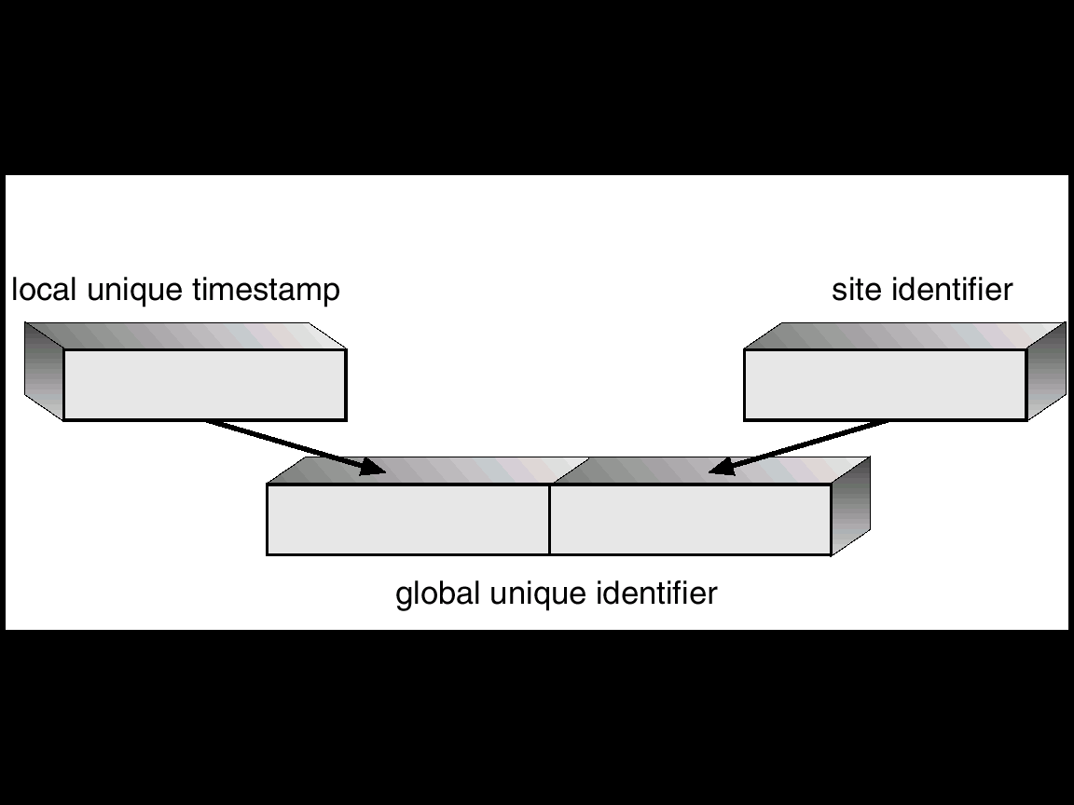
Generation of Unique Timestamps
Manoj Kumar Jain Professor Computer Science MLSU Udaipur

Slide 27
Thanks
Manoj Kumar Jain Professor Computer Science MLSU Udaipur

